Slide 1
Compare and
Contrast
By Jennifer Adams
Platte Valley Elementary
4th Grade

Slide 2
Compare
When you compare 2 things you ask yourself,
"How are these things alike?"

Slide 3
Contrast
When you contrast 2 things you ask yourself,
"How are these things different?"

Slide 4
Signal Words
Compare
Contrast
Like
Same as
More
Similar
Likewise
Both
Each
Also
Same
Too
Different
But
On the other hand
However
Unlike
Different from
In contrast
Less

Slide 5
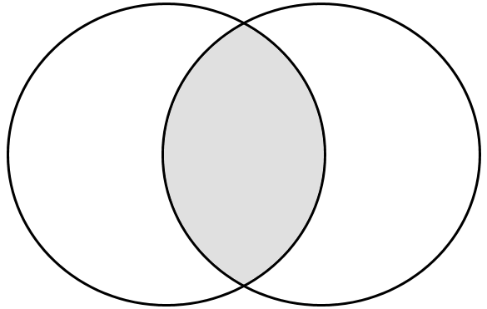
Ways to Compare and Contrast
T-Chart
Venn Diagram
Alike (Compare)
Different (Contrast)

Slide 6

Let me show you!
Lets compare and contrast a car and a skateboard.

Slide 7
Car vs. Skateboard
Alike (Compare)
Different (Contrast)
They each have wheels
They are both types of transportation
Cars come in different colors and skateboards do, also.
A car costs money and a skateboard does, too.
A car is large, but a skateboard is small
You usually sit in a car, unlike a skateboard that you usually stand on
Many people can ride in a car, however only one person rides on a skateboard.
A car has door, on the other hand a skateboard does not

Slide 8


Lets try it together!
Lets compare and contrast a dog and a cat.

Slide 9
Let’s try it together
Dogs
Cats
Both
They make barking, howling, and growling sounds
Daytime animals
Live in packs in the wild
They meow and purr
Nocturnal animals
Live by themselves in the wild
Both have hair
Have 4 legs
Each are carnivores
What are more similarities and differences?

Slide 10
Your turn!
Lets compare and contrast canned foods and fresh foods.

Slide 11
Read this passage comparing and contrasting fresh foods verses canned foods. Complete the chart comparing and contrasting fresh foods and canned foods.
Eating is an activity that we as humans do at least two times a day. We decide what we are about to eat and how it will affect our bodies. The purpose of this essay is to compare and contrast the differences between eating fresh foods instead of canned foods. The three main differences are flavor, health benefits, and cost.
The most notable difference between these two kinds of foods is their flavor. Fresh foods have great flavor and taste because they keep all their natural conditions. Canned foods however, lack a lot of its flavor characteristics because there are some other chemical products added to the natural foods. It is logical that the fresh foods will have a greater taste and flavor when consumed. However, they take more time to prepare.
Comparing both types of foods we notice another difference. There is a health factor that affects both of them. Canned foods loose some of the original fresh food nutrients when stored, and also it has to be canned with many conservatives and chemical factors that prolong the shelf life and apparent freshness of the food.
Yet another difference between these two types of foods is the cost. Canned foods are much more expensive than fresh foods. Here the benefit of buying canned foods is that they are easier to find, for example, in a supermarket instead of the market like the fresh foods. In addition, they require less work to prepare than fresh foods, just open and serve.
Here are the main three differences between buying fresh foods and buying canned foods. As we can see it comes down to a personal choice, based on the time each person has, the money and the importance he/she gives to his/her nutrition and health. Therefore it is important that you consider your possibilities and choose the best type of foods for your convenience and lifestyle.

Slide 12
Now Try it on your own!
Use your Venn diagram and the essay to compare and contrast canned and fresh foods.
Fresh Foods
(Contrast)
Canned Foods
(Contrast)
Compare (similarities)

